Slide 1
NLP Transformers lecture 05.2
Branko Žitko
Source: DeepLearning.AI

Slide 2
Contents
Transformers intuition
Self-attention
Multi-head attention
Transformers

Slide 3














Transformers Motivation
Increased complexity,
sequential
RNN
GRU
LSTM
$$y^{<t>}$$
$$y^{<t>}$$
softmax
$$y^{<t>}$$
$$c^{<t−1>}$$
$$c^{<t>}$$
softmax
$$a^{<t>}$$
*
+
softmax
$$a^{<t−1>}$$
tanh
$$a^{<t−1>}$$
$$a^{<t>}$$
$$a^{<t−1>}$$
*
*
$$a^{<t>}$$
tanh
tanh
σ
σ
σ
tanh
σ
$$x^{<t>}$$
$$x^{<t>}$$
$$x^{<t>}$$

Slide 4
Transformers Intuition
Attention + CNN
Self-Attention
Multi-Head Attention
[Vaswani et al. 2017, Attention Is All You Need]

Slide 5
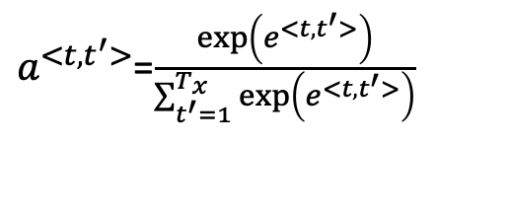
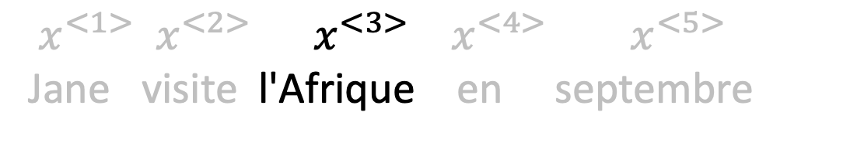
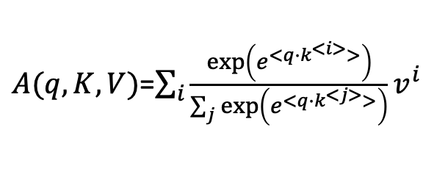
Self-Attention Intuition
$A\left(q,K,V\right)$ = attention-based vector representation of a word
RNN Attention
Transformers Attention
$a^{<t, t^{′}>}$=$\frac{\exp\left(e^{<t, t^{′}>}\right)}{\sum_{t^{′}=1}^{T_{x}}{\exp\left(e^{<t, t^{′}>}\right)}}$
$A(q,K,V)$=$\sum_{i}{\frac{\exp\left(e^{<q∙k^{<i>}>}\right)}{\sum_{j}{\exp\left(e^{<q∙k^{<j>}>}\right)}}v^{i}}$
$x^{<1>}$ $x^{<2>}$ $x^{<3>}$ $x^{<4>}$ $x^{<5>}$
Jane visite l'Afrique en septembre
[Vaswani et al. 2017, Attention Is All You Need]

